Slide 1
Bias in Commodity Flow Survey ML: A Case Study
Christian Moscardi

Slide 2
Disclaimer: Any opinions and conclusions expressed herein are those of the author(s) and do not represent the views of the U.S. Census Bureau or the Bureau of Transportation Statistics. All results have been reviewed to ensure that no confidential information is disclosed.
The Census Bureau has reviewed this data product for unauthorized disclosure of confidential information and has approved the disclosure avoidance practices applied.
(Approval ID: CBDRB-FY20-ESMD002-010)

Slide 3
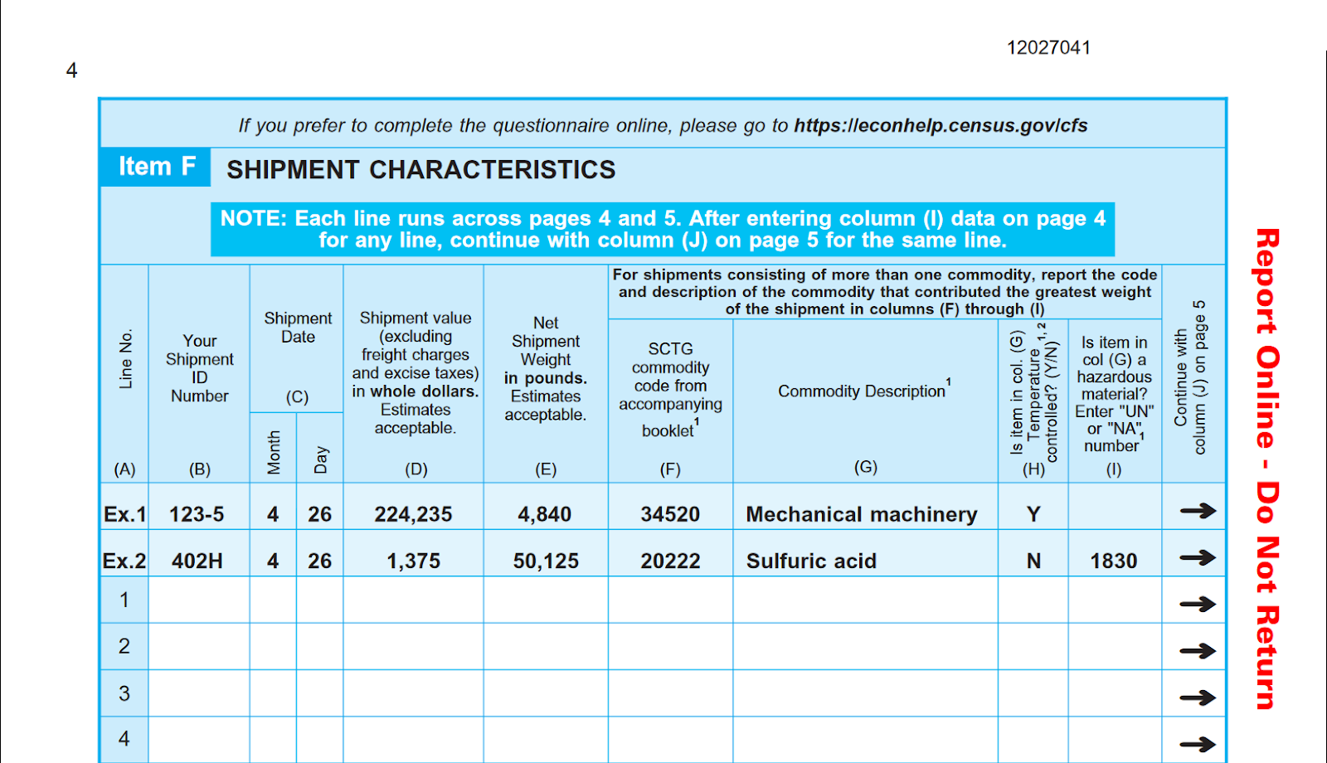
Overview
Commodity Flow Survey
Commissioned by BTS
Conducted every 5 years (2012, 2017)
Respondents provide sampling of shipments from each quarter

Slide 4
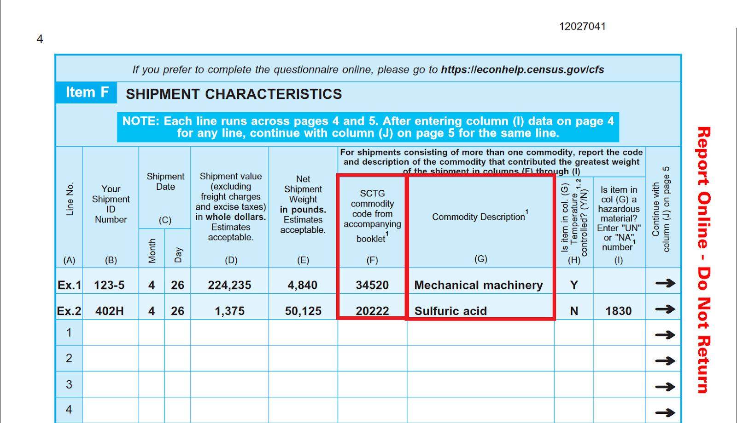
Overview
Commodity Flow Survey
Commissioned by BTS
Conducted every 5 years (2012, 2017)
Respondents provide sampling of shipments from each quarter

Slide 5
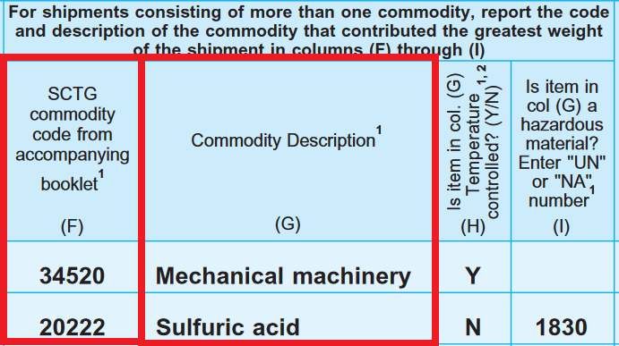

Slide 6
Overview
ITEM G - Other Clarifying Information
"Pulling this information was a huge spend of time and resources.“
"Just glad this is over!!"

Slide 7
Overview
Using Machine Learning, can we automate the assignment of SCTG codes to shipment records?
(Yes.)

Slide 8
What are the potential impacts of bias?
Impact on product: increased or decreased estimates of freight activity by product type
Survey informs transportation planning decisions & resource allocation
Could lead to increased/decreased spending on various types of infrastructure
Bias potential: State/local DOTs could misunderstand the types of products being brought into / exported from their communities, misallocate resources
Impact on process: reduced time spent assigning product codes & correcting data
We see limited risk given this activity strictly reduces respondent + analyst workload
Notes:
“allocative bias” is a term that pops up quite a bit in ML fairness literature, and that’s exactly the sort of risk we run with systematic errors in our classification system.

Slide 9
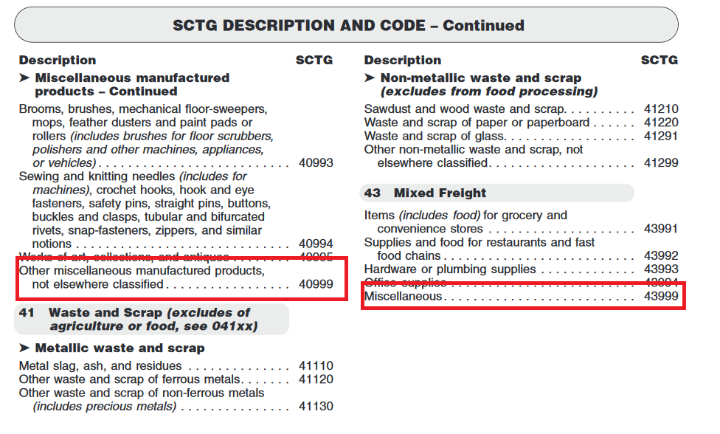
Initial Investigation
Data
Labelled Records (6.4M) from 2017 CFS
For training, de-duplicating leads to ~500,000 unique descriptions
Miscellaneous Codes
Notes:
Before even modelling, talk with analysts, they immediately highlighted these two specific codes as points of concern in data quality.

Slide 10
Initial Investigation
Description | Product Code
ANTENNA M20 - 20L | 40999
CAULKING TOOLS | 40999
PLASTIC CONTINAER | 43999
CLEANING FLUID 2-OZ BOTTLE | 40999
26 GAGUE 5' S/L PIPE | 40999
DINING TABLE | 40999
MODEL SHIP | 43999
PLUS DISPR LIQ-;A COMP 1GAL 48 PLT | 40999
SHEAVE, IDLER, ASSEMBLY | 40999
CONTROL DEVICE | 40999
Solution: remove 40999, 43999 from training data
Lesson learned: know your data and work with subject experts!
Notes:
This is a random sampling of 10 descriptions within these two miscellaneous codes from the original, uncorrected data. First off, “model ship” and “plastic container” are not mixed freight, and furthermore, every single item here can be better classified! (Especially when you look at more context from the shipment than just the description).
In other words, these categories are filled with systematically awful data! Based on the descriptions, not a single one of these records should actually be coded as mixed freight or a miscellaneous product. A huge bias coming from respondents growing frustrated with looking through the coding scheme.
One other fun fact: the biggest source of these 40999 codes actually comes from a step in the survey production where the National Processing Center was instructed to fill blank SCTG codes with 40999 on paper forms.

Slide 11
Initial Model
Preprocessing
Remove numeric, spell-check, stem
Feature engineering
“Bag-of-words” + TF-IDF scores
NAICS codes for industry context
Modelling
Logistic Regression, “elastic net” regularization
Cross-validate, hold out test set, etc.
Initial Results: 50% “accuracy”
28 STEEEL BEAM,S
28 STEEEL BEAM S
STEEEL BEAMS
steeel beams
steel beams
steel beam

Slide 12
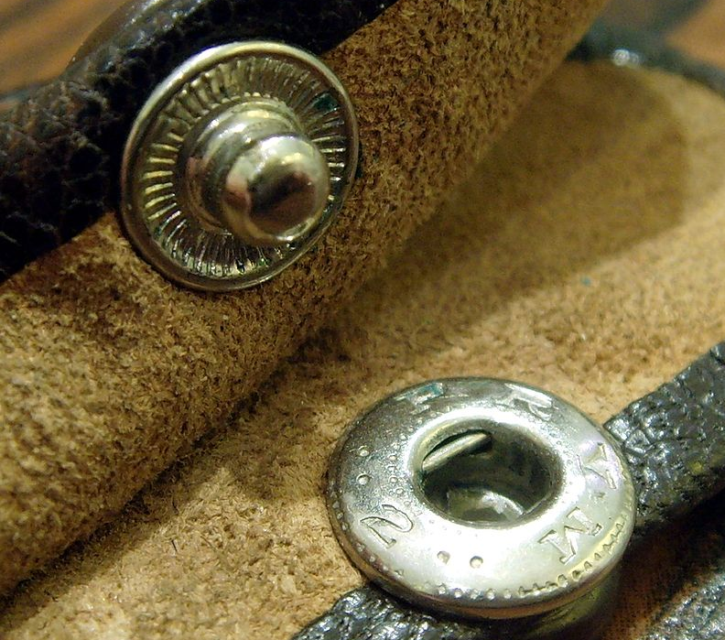
Further Investigation
E.g. 40994
Sewing and knitting needles (includes for machines) crochet hooks, hook and eye fasteners, safety pins, straight pins, buttons, buckles and clasps, tubular and bifurcated rivets, snap-fasteners, zippers, and similar notions.
Image courtesy Wikimedia commons
Notes:
Compare this to the spaceship categories

Slide 13
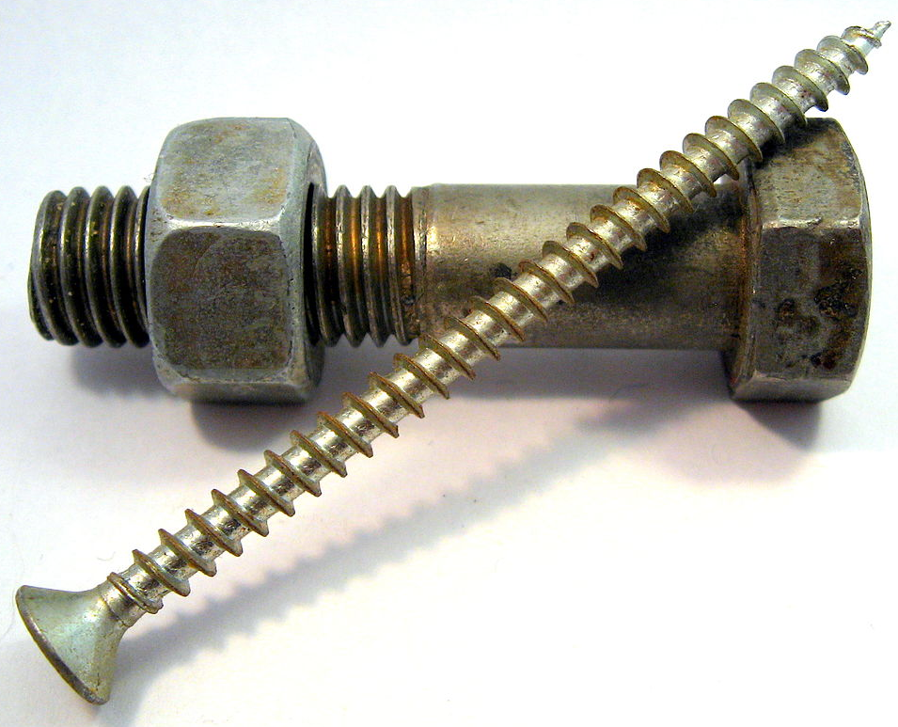
Further Investigation
Model’s prediction
33310
Nails, screws, bolts, nuts, washers, staples except in strips, and similar fastening articles
What was the NAICS Code?
Image courtesy Wikimedia commons

Slide 14
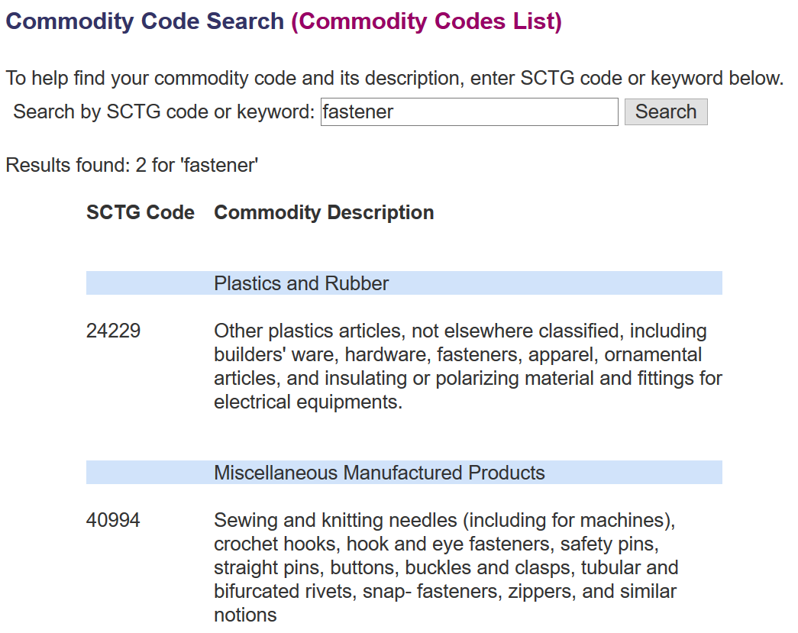
Further Investigation
Manually validating, about 50% of items labelled 40994 by respondents were miscoded.
We can see the workflow which led to these miscodings
We use the model to help target classification errors in data.
Notes:
Lesson learned: investigate areas your model is classifying worse than you’d hope. Use the model and performance metrics as a tool to dig deeper into what’s happening, and understand the process by which your model is arriving at its conclusion. Then, work with experts to validate data quality and other potential biases as necessary.

Slide 15
Let’s Experiment
Proof-of-concept: ran model on 170,000 unlabeled/invalid records
70,000 with probability score above predefined threshold [.5 – 1)
Determined by coarse inspection w/ analysts
CFS Analysts validate a sample of 350 unique records
Also wanted to determine accuracy in the [0 - .5) threshold
Took sampling of the other 100,000 unlabeled / invalid records.
Model probability ranges [0 - .5)
60 from each range

Slide 16
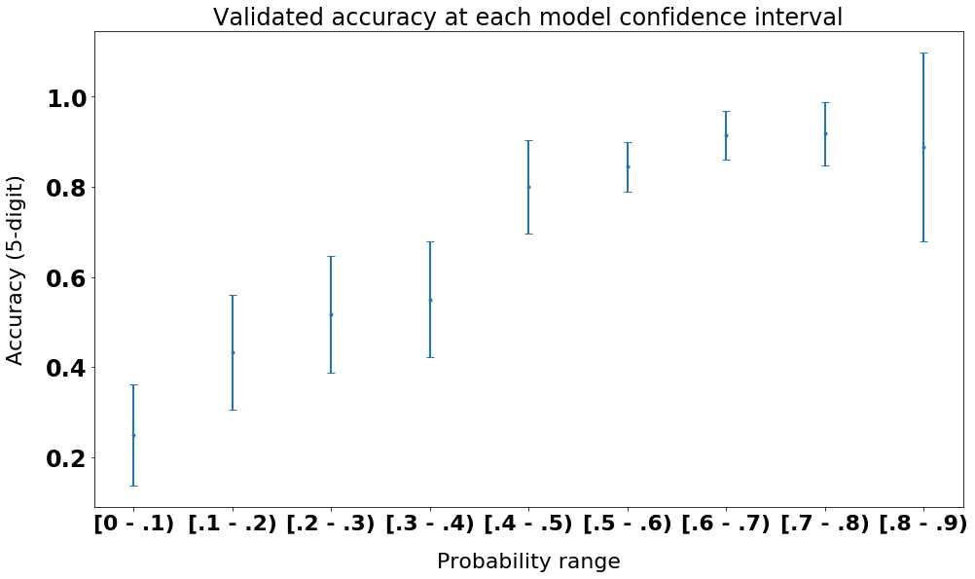
Results
Validation: 89% correct in [.5 -1); 80% in [.4 - .5)
Can apply this as an imputation strategy for those 100k
Also ran similar procedure to relabel some of those pesky 40999, 43999 codes
Figure: validation accuracy for each model probability / confidence range. Bars are 95% Bernoulli CI
(Approval ID: CBDRB-FY20-ESMD002-010)

Slide 17
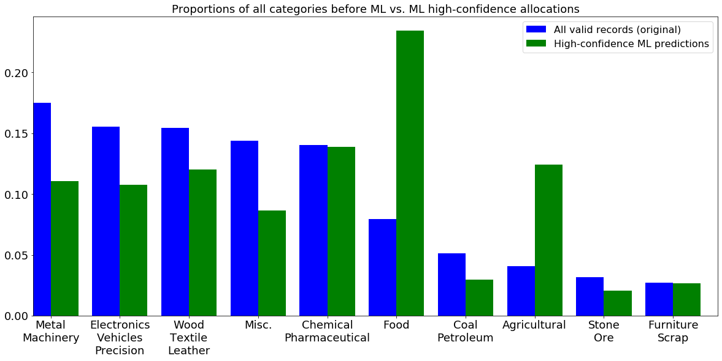
What about Bias?
(Approval ID: CBDRB-FY20-ESMD002-010)
Notes:
As we can see, the model is confident about assigning records into food and agricultural categories at a much higher rate. We do have a proxy for product type – industry -- and we look at the industries the unlabeled data is coming from it does not indicate that significantly more unlabeled records are food-related. More likely, the model is especially confident about these.
Fun fact: one potential explanation for higher data quality in food categories is that they’re at the top of the codebook!

Slide 18
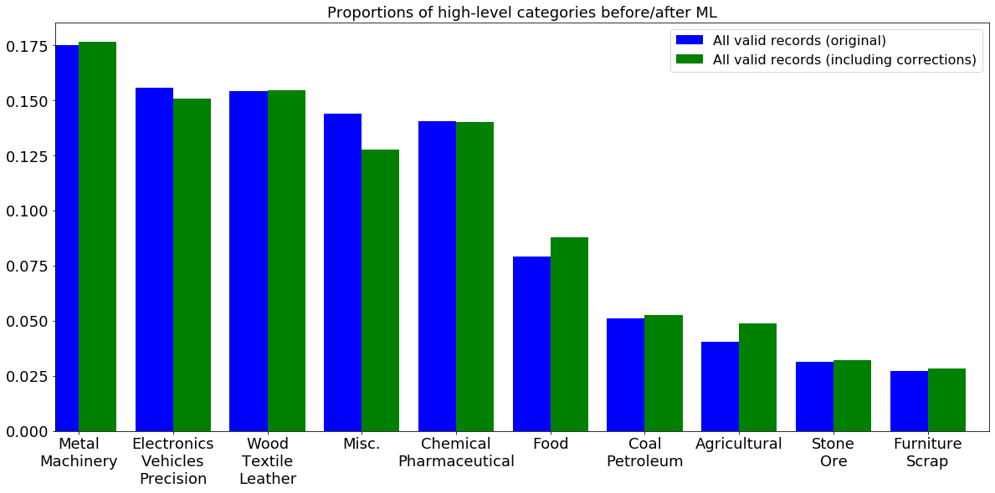
What about Bias?
(Approval ID: CBDRB-FY20-ESMD002-010)
Notes:
As we can see, the model is confident about assigning records into food and agricultural categories at a much higher rate. We do have a proxy for product type – industry -- and we look at the industries the unlabeled data is coming from it does not indicate that significantly more unlabeled records are food-related. More likely, the model is especially confident about these.
Fun fact: one potential explanation for higher data quality in food categories is that they’re at the top of the codebook!

Slide 19
What biases affect CFS ML?
Response bias (data)
Codebook is burdensome; search tool itself introduced bias by making only certain codes visible; misc. codes
Omitted variable bias (model + data)
E.g. in database, product descriptions are limited to 150 chars
Writing limits # of words respondents can provide
Automation + Confirmation bias (model + data)
Analysts may be predisposed to confirm the model’s classification
System drift (data + classification scheme)
Products themselves change over time; new products introduced. Does coding scheme capture this?
Notes:
Going to primarily focus on a few examples of response bias. Throughout the talk I’ll highlight situations where we can run into these other risks.
This is by no means comprehensive!!

Slide 20
Zoom out: what are the potential impacts of autocoding bias?
Depends on the application
Veterans’ disability codes
Product: disability codes assigned to claims
Process: can the claims of certain demographics be processed faster?
ACS occupation codes
Product: ACS estimates of occupations by demographics
Process: 70% of cases are currently human coded
Notes:
Just a couple of other quick examples from across government.
VA autocodes veterans’ disability claims. An inaccurate claim could result in inaccurate benefits or misallocation of resources. In addition, the classification model may not confidently be able to predict on all claims. Is there bias in those whom the model can confidently provide a code for?
ACS has humans code occupation for 70% of cases. This can skew the distribution of estimates of occupation across the country and subsequently affect policy that’s informed by this data. On the other hand, we wouldn’t really care which particular occupations the model might be especially good at coding. ACS has other adjacent statistical concerns, such as continuity of timeseries.
[1] https://www.census.gov/library/working-papers/2015/demo/2015-Day-Chiu-Montalvo-01.html

Slide 21
Thank you!
Christian: Christian.L.Moscardi@census.gov

Slide 22
References
1. https://towardsdatascience.com/understanding-and-reducing-bias-in-machine-learning-6565e23900ac

Slide 23
Biggest issue: Response Bias
Questionnaire mailed
Extract shipment data from ERP/TMS
Sample shipments
U.S. Census Bureau
Survey Respondent
Data received by Census
Enter data into online questionnaire
Find SCTG codes
Notes:
First, we’ll focus on response bias.
Questionnaire mailed: Census does lots of interviewing to minimize response bias on questionnaire. One of the nice things of working at a statistical agency. However, some “corner cases” may be ignored by respondents (e.g. the product reported should be the heaviest weight in the box).
Data extraction: respondents might not store a particular variable in database – they’d have to manually infill. Plenty of opportunity for error. Or, certain shipment types that are meant to be excluded might not be excluded. What if there are systematic biases in their data?
Enter data into online questionnaire: this transcription process can introduce really interesting errors. E.g. some product codes start with a 0, and those were initially truncated when data was entered into questionnaire. Or, if you try to drag down on a spreadsheet, Excel will auto-increment numbers, so we saw a lot of that.

Slide 24
Biggest issue: Response Bias
Questionnaire mailed
Extract shipment data from ERP/TMS
Sample shipments
U.S. Census Bureau
Survey Respondent
Data received by Census
Enter data into online questionnaire
Find SCTG codes
Notes:
Now, let’s really focus on what happens when respondents find SCTG codes, as it’s the main source of bias for our data.

